Slide 1
CS 4530: Fundamentals of Software Engineering Module 2, Lesson 4 When Have I Written Enough Tests?
Rob Simmons
Khoury College of Computer Sciences

Slide 2
Learning Goals for this Lesson
At the end of this lesson, you should be able to
Explain how TypeScript types and documented preconditions influence what tests you need to write
Explain what code coverage is, and how different measures differ, including statements, branches, functions, and lines
Explain the benefits of mutation testing

Slide 3
Testing and preconditions
What input values do I need to test this function on?
/**
* Prints "hello" repeatedly
*
* @param numHellos - number of times to apply fn to base,
* must be an integer >= 0
*/
function iterateNTimes(numHellos: number) {
for (let i = numHellos; i !== 0; i--) {
console.log('hello’);
}
}

Slide 4
Testing and preconditions
What input values do I need to test this function on?
Edge cases (definitely 0)
Probably 1 and some larger number? But most numbers > 1 are kind of interchangeable.
If we want to sound fancy we’ll call these “equivalence classes of inputs.”
What about -3? What about 1.4? What about null or { lol: 'owned' } ?
/**
* Prints "hello" repeatedly
*
* @param numHellos - number of times to apply fn to base,
* must be an integer >= 0
*/
function iterateNTimes(numHellos: number)

Slide 5
Testing and TypeScript
TypeScript types are, at the end of the day, no better than precondition comments.
iterateNTimes({ lol: 'owned ' } as unknown as number)
They do at least make it less likely you’ll screw up accidentally…
It makes sense sometimes to treat your precondition comments as not-needing-to-be tested
It makes sense often to treat your TypeScript types as not-needing-to-be-tested
Extra defensive checks have their own costs!

Slide 6
Code Coverage
The industry standard answer for “have I written enough tests”
Measures “how much of your code” is exercised by your tests
If none of your test even execute a piece of code, it’s definitely not being tested!

Slide 7
Code Coverage
Line and Statement coverage: coarsest measure.
Testing x = 0 exercises lines 1 and 2
Testing x = 10 exercises lines 1, 4, 5, and 6.
1| if (x === 0) {
2| return 3;
3| }
4| const y = x > 4 ? 2 : 3;
5| const z = x % 2 == 0 ? 1 : 2;
6| return x / (y - z);

Slide 8
Code Coverage
Branch coverage: most widely used in industry.
Testing with x > 4 and x <= 4 necessary to handle both branches on line 4.
Testing with odd and even numbers necessary to handle both branches on line 5.
The values -2, 0, 1, and 10 get full branch coverage.
1| if (x === 0) {
2| return 3;
3| }
4| const y = x > 4 ? 2 : 3;
5| const z = x % 2 == 0 ? 1 : 2;
6| return x / (y - z);

Slide 9
Code Coverage
The values -2, 0, 1, and 10 get full branch coverage…
…but 5 causes line 6 to divide by zero!
In JavaScript/TypeScript, this doesn’t cause an exception, there’s a number called “NaN” for “not a number”
Path coverage covers all combinations of branches, but is infeasible in practice.
1| if (x === 0) {
2| return 3;
3| }
4| const y = x > 4 ? 2 : 3;
5| const z = x % 2 == 0 ? 1 : 2;
6| return x / (y - z);

Slide 10
Code Coverage
Total code coverage — by any metric — does not mean no bugs
Running code doesn’t mean checking that it’s doing the right thing!
Coverage checking can be invaluable at identifying when you think you’re testing something but you’re not, which is a real problem in practice.
Test-Driven Development also valuable for this problem: it’s important that tests switch from failing to succeeding when you expect them to.

Slide 11
Adversarial Testing
It is helpful to think of testing as a game in which you play against an adversary.
Your adversary plays by producing multiple versions of code that you agree is buggy, and multiple versions of code you agree is correct.
Your win if your tests catch all the buggy code, and pass all the correct code.

Slide 12

Adversarial Testing
Original code (correct)
// find the first item in the list that is
// greater than or equal to the target.
export default function search(list:number[], target:number) {
return list.find((item) => item >= target);
}
Mutated code (buggy)
// find the first item in the list that is
// greater than or equal to the target.
export default function search(list:number[], target:number) {
return list.find((item) => item > target);
}
Notes:
The idea of "mutation testing" is that most defects are the result of simple errors. (Is this a realistic assumption? Spoiler alert: it's realistic enough!)
In mutation testing, the adversary generates buggy code by making simple changes. Generating buggy code in this way is clearly automatable.
Note that this is the kind of mistake that you might make if you were in a hurry, or tired, or it was late at night.
Snidely Whiplash (over there on the right) asks "can you tell the difference"?
(Recall that a while ago we promised you help in making sure that your regions have the right boundaries. This will help!)

Slide 13
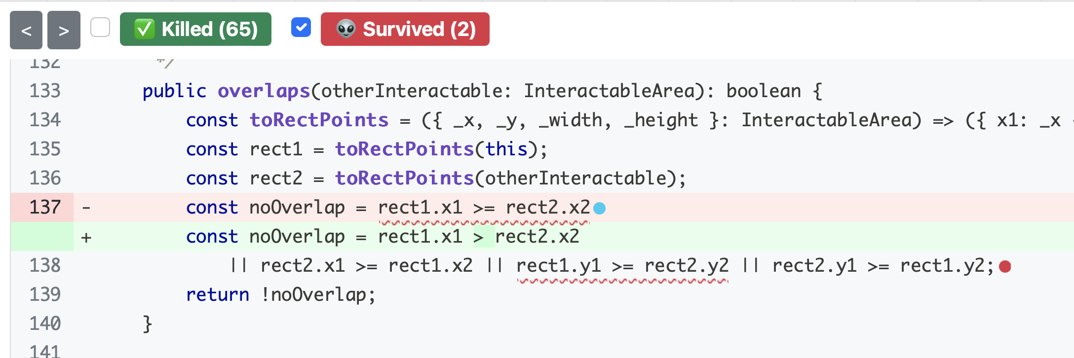
Adversarial Testing
Stryker is a mutation tester for JavaScript — an automated adversary!
Notes:
The idea of "mutation testing" is that most defects are the result of simple errors. (Is this a realistic assumption? Spoiler alert: it's realistic enough!)
In mutation testing, the adversary generates buggy code by making simple changes. Generating buggy code in this way is clearly automatable.
Note that this is the kind of mistake that you might make if you were in a hurry, or tired, or it was late at night.
Snidely Whiplash (over there on the right) asks "can you tell the difference"?
(Recall that a while ago we promised you help in making sure that your regions have the right boundaries. This will help!)

Slide 14
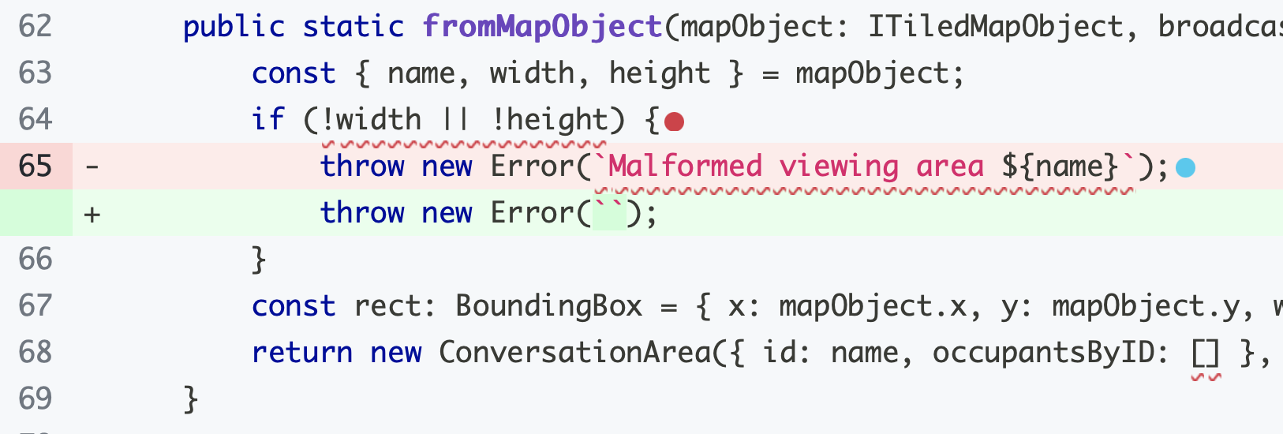
Adversarial Testing
Stryker is a mutation tester for JavaScript — an automated adversary!
Sometimes it loses the game because mutants aren’t bugs.
Notes:
The idea of "mutation testing" is that most defects are the result of simple errors. (Is this a realistic assumption? Spoiler alert: it's realistic enough!)
In mutation testing, the adversary generates buggy code by making simple changes. Generating buggy code in this way is clearly automatable.
Note that this is the kind of mistake that you might make if you were in a hurry, or tired, or it was late at night.
Snidely Whiplash (over there on the right) asks "can you tell the difference"?
(Recall that a while ago we promised you help in making sure that your regions have the right boundaries. This will help!)

Slide 15
Review
It’s the end of the lesson, so you should be able to:
Explain how TypeScript types and documented preconditions influence what tests you need to write
Explain what code coverage is, and how different measures differ, including statements, branches, functions, and lines
Explain the benefits of mutation testing

